Slide 1
PHP Session and Cookie
Course Code: CSC 3215
Course Title: WEB TECHNOLOGIES
Dept. of Computer Science
Faculty of Science and Technology
Lab No: | 5 | Week No: | 5 | Semester:
Lecturer: | Supta Richard Philip & richard@aiub.edu

Slide 2
Lecture Outline
Learning outcome
Cookie
Example of cookie
Delete a Cookie
PHP Session
Example of session
Uses of session
Books and References

Slide 3
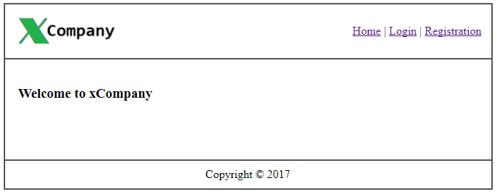
Learning outcome
In this lecture, we will learn temporary storage like Session & Cookie and their usage using PHP.
Suppose we want to create one web application as following.

Slide 4
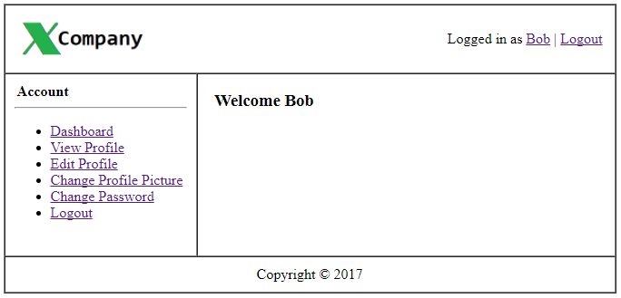
After Login the system
We can perform the following operation after successfully logged in.
In that case, we need session to track user.
Sessions are a simple way to store data for individual users against a unique session ID.

Slide 5
Example of Cookie
<?php $cookie_name = "user"; $cookie_value = "Alex Porter"; setcookie($cookie_name, $cookie_value, time() + (86400 * 30), "/"); ?> <html> <body> <?php if(!isset($_COOKIE[$cookie_name])) { echo "Cookie named '" . $cookie_name . "' is not set!"; } else { echo "Cookie '" . $cookie_name . "' is set!<br>"; echo "Value is: " . $_COOKIE[$cookie_name]; } ?> </body> </html>

Slide 6
Delete a Cookie
<?php // set the expiration date to one hour ago setcookie("user", "", time() - 3600); ?>
Check if Cookies are Enabled
<?php if(count($_COOKIE) > 0) { echo "Cookies are enabled."; } else { echo "Cookies are disabled."; } ?>

Slide 7
PHP Session
A session is a way to store information (in variables) to be used across multiple pages.
Sessions are a simple way to store data for individual users against a unique session ID.
Session variables are set with the PHP global variable: $_SESSION.
The session_start() function must be the very first thing in your document. Before any HTML tags.

Slide 8
Example of session
<?php session_start(); ?> <!DOCTYPE html> <html> <body> <?php // to change a session variable, just overwrite it $_SESSION["favcolor"] = "yellow"; print_r($_SESSION); ?> </body> </html>
To remove or destroy session.
<?php // remove all session variables session_unset(); ?>

Slide 9
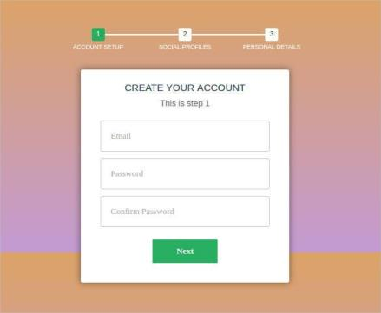
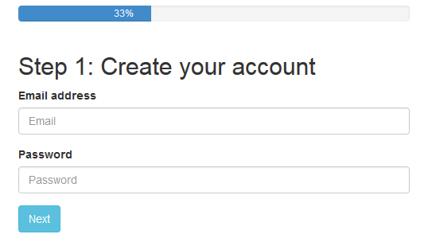
Uses of session
PHP Login Form /Log out with Sessions.
Creating a multi-page registration form using PHP and session.
Creating a multi-page order form using PHP and Sessions.
More details, we will see in the lab class.

Slide 10
Books
W3Schools Online Web Tutorials; URL: http://www.w3schools.com
PHP Documentation; URL: http://www.php.net/docs.php
Sams Teach Yourself Ajax JavaScript and PHP All in One; Phil Ballard and Michael Moncur; Sams Publishing; 2010
JavaScript Phrasebook; Christian Wenz; Sams Publishing; 2007
PHP and MySQL Web Development, 4/E; Luke Welling and Laura Thomson; Addison-Wesley Professional; 2009
JavaScript for Programmers Paul J. Deitel and Harvey M. Deitel; Prentice Hall; 2009
Beginning PHP5, Apache, and MySQL Web Development; Elizabeth Naramore, Jason Gerner, Yann Le Scouarnec, Jeremy Stolz and Michael K. Glass; Wiley Publishing; 2005
XML in a Nutshell, 3/E; Elliotte Rusty Harold and W. Scott Means; O'Reilly Media; 2004

Slide 11
References
https://www.codeofaninja.com/2013/03/php-login-script.html
https://html.form.guide/php-form/php-order-form.html
https://www.tutorialspoint.com/php/php_login_example.htm
https://codewithawa.com/posts/admin-and-user-login-in-php-and-mysql-database

